Slide 1
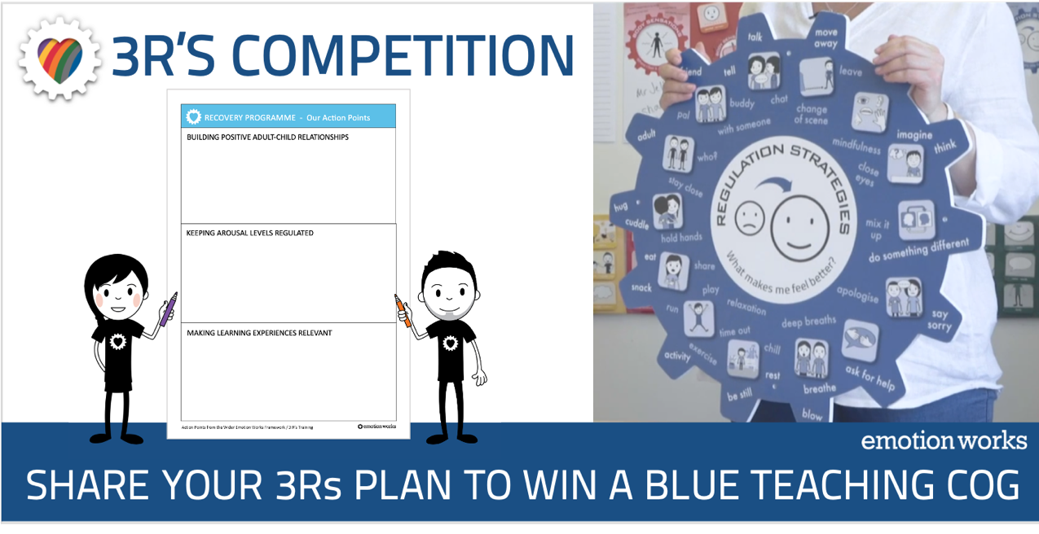
The task: Share your 3Rs plan, and then share a follow up account of how it went.
Choose whether you’ll create a plan for you whole school, a class or group, or an individual -
see slides 6, 7 & 8 for an example plan for each.
How to enter
Add 1 or 2 ideas for each of the 3Rs for your learner or group using Slide 2.
Save slide 2 as a pdf (go to print, select 'pdf' in the bottom left corner, select 'save as pdf').
Send your saved pdf to me in messenger or email by 31st March at the latest.
Carry out your plan over the settling back period, including after the Easter holidays. Make observations, take photos, keep notes, ask for pupil feedback. Provide a 3-slide summary account of the impact of your plan over slides 3-5. Save slides 2-5 as a pdf and send to me by the closing date of 7th May.
I'm very happy to receive plans asap, so we can share with newer practitioners.
Good luck, and happy planning 😊
Some references and resources
The 3Rs training page on the Recovery Website
The 'Settling in /Settling Back' teaching page on the Recovery Website
The Blue Cog teaching page on the Recovery Website
The 3Rs practitioner network meeting recording
Full Members - Browse our Practice Ideas for motivating learning activities/ filter for Blue Cog ideas
https://www.emotionworks.org.uk/members/practice-ideas/
Why are we running this competition?
To encourage and share lots of pro-active planning around the 3Rs so that as many children as possible benefit from teachers putting the 3Rs principles into practice
To bring some added value to your EW membership and support lots of community connection in a way that offers some Relationship, Regulation and Relevance support to you too!
Because we like giving away our resources in exchange for your brilliant ideas, that we can then share with the rest of the EW community Everyone's a winner!!

Slide 2
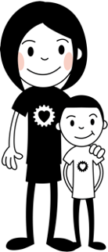
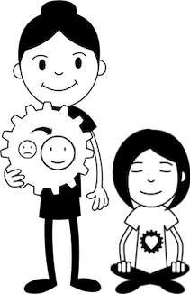

3Rs plan for WHOLE SCHOOL | CLASS or GROUP | INDIVIDUAL
Briefly describe your learner or group
To what extent has your learner or group already been introduced to Emotion Works?
Activities, routines or environment changes
(note – you do not have to use Cog ideas for this planning)
Information here
Information here
Information here

Slide 3
How it went: RELATIONSHIP IDEAS & ACTIVITIES
Please provide a summary of 1 or 2 Relationship ideas that worked well, and you feel had a positive impact on the settling back to school period.
You could include...
A brief description of the activity or strategy
A photo or 2
Reflection notes
Pupil feedback

Slide 4
How it went: REGULATION IDEAS & ACTIVITIES
Please provide a summary of 1 or 2 Regulation ideas that worked well, and you feel had a positive impact on the settling back to school period.
You could include...
A brief description of the activity or strategy
A photo or 2
Reflection notes
Pupil feedback

Slide 5
How it went: RELEVANCE IDEAS & ACTIVITIES
Please provide a summary of 1 or 2 Regulation ideas that worked well, and you feel had a positive impact on the settling back to school period.
You could include...
A brief description of the activity or strategy
A photo or 2
Reflection notes
Pupil feedback

Slide 6
Example

Slide 7
Example

Slide 8
Example

